Slide 1
Java 4 WEB
Lesson 4 - Exceptions

Slide 2
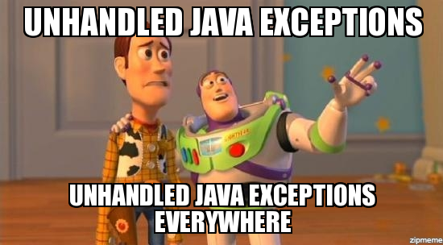
Lesson goals
Exceptions
Assertions
Notes:
Program tries to read a file that doesn’t exist.
Program tries to access a database, but the network connection to the database is unavailable.
Dev wrote an invalid SQL statement in your JDBC code.
Dev used the wrong format specifiers when using DateTimeFormatter.
Wrong arguments, validation fails…

Slide 3
What is exception?
“I give up. I don’t know what to do right now. You deal with it.”
An exception indicates that something unexpected happened

Slide 4
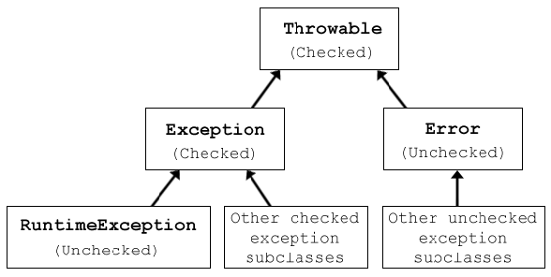
Exception hierarchy

Slide 5
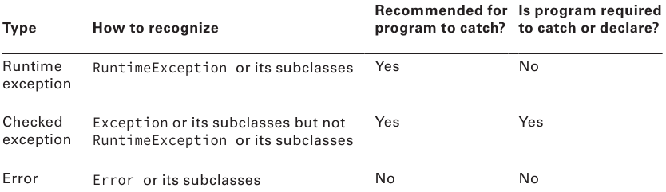
Exception types
Notes:
java.lang.Exception - Errors that are expected. In some cases, the program can recover itself from them (IOException, ParseException, SQLException)
java.lang.RuntimeException - Unexpected errors generated at runtime. In most cases, the program cannot recover itself from them (ArithmeticException, ClassCastException, NullPointerException)
java.lang.Error - Represents serious problems or abnormal conditions that a program should not deal with. Some examples are: AssertionError, IOError, LinkageError, VirtualMachineError

Slide 6
Common exceptions
ArithmeticException
ArrayIndexOutOfBoundsException
ClassCastException
IllegalArgumentException
NullPointerException
…
Notes:
ArithmeticException - by the JVM when code attempts to divide by zero.
ArrayIndexOutOfBoundsException - by the JVM when use an illegal array index
ClassCastException - by the JVM when an attempt is made to cast an object to a subclass of which it is not an instance.
IllegalArgumentException – by program indicate that inappropriate argument.
NullPointerException - by the JVM when there is a null reference where an object is required

Slide 7
Exception population
public User auth(String username) { throw new UserNotFoundException(); }
Notes:
The throw keyword is used when you actually want to throw an exception.

Slide 8
Exception handling: Declare
public static Date parse(String date) throws ParseException { SimpleDateFormat sdf = new SimpleDateFormat("MM/dd"); return sdf.parse(date); }
Use throws only for checked exceptions
Notes:
The throws keyword indicates the exceptions that a method can throw. The throws keyword is used in a method declaration. Overriding method is allowed to declare more specific exceptions than the parent or even none at all.

Slide 9
Exception handling: Catch
public static Date parse(String date) { SimpleDateFormat sdf = new SimpleDateFormat("MM/dd"); try { return sdf.parse(date); } catch (ParseException e) { log("Date parse failed", e); return null; } }
Notes:
try - encloses code that might throw an exception, it doesn't matter if it's a checked or an unchecked one.
catch - used to handle an exception. It defines the type of the exception and a reference to it.

Slide 10
Unreachable exception handler
try { System.out.println("Hello"); } catch (SQLException e) { // Compile-time error
logger.error(“SQLException caught”, e); }
Notes:
Java will not allow you to declare a catch block for a checked exception type that cannot potentially be thrown by the try clause body

Slide 11
Exception catch blocks order
try { SimpleDateFormat sdf = new SimpleDateFormat("MM/dd"); Date date = sdf.parse("01-10"); System.out.println(date); } catch (ParseException e) { log(“Date parse failed”, e); } catch (Exception e) { log(“Unexpected error”, e);
}
Notes:
Java checks the catch blocks in the order in which they appear.
Child class exception should be before parent class

Slide 12
Default exception handler
Prints out exception description;
Prints the stack-trace;
Causes the program to terminate.
Notes:
If no exception handlers are configured, JVM provides a default exception handler that performs the following tasks
stack-trace - hierarchy of methods where the exception occurred

Slide 13
Using Multi-catch
try { Path path = Paths.get("dolphinsBorn.txt"); String text = new String(Files.readAllBytes(path)); LocalDate date = LocalDate.parse(text); System.out.println(date); } catch (DateTimeParseException e) {
throw new RuntimeException(e); } catch (IOException e) {
throw new RuntimeException(e); }

Slide 14
Using Multi-catch
try { Path path = Paths.get("dolphinsBorn.txt"); String text = new String(Files.readAllBytes(path)); LocalDate date = LocalDate.parse(text); System.out.println(date); } catch (DateTimeParseException | IOException e) { throw new RuntimeException(e); }
Notes:
Multi-catch allows you to write code without duplication
Multi-catch is Effectively final
Syntax – pipeline separated and only one variable
Exceptions should be in different hierarhi

Slide 15
Issues?
try { mightThrow(); } catch(FileNotFoundException | IllegalStateException e) {
e = new RuntimeException(); } catch(InputMismatchException e | MissingResourceException e) {
} catch(FileNotFoundException | IOException e) { } catch(SQLException e){ } catch(FileNotFoundException | IllegalArgumentException e) {
} catch(Exception e) { } catch(IOException e) { }
private void mightThrow() throws DateTimeParseException, IOException { }

Slide 16
Issues
try { mightThrow(); } catch(FileNotFoundException | IllegalStateException e) {
e = new RuntimeException(); // in multicatch variable is effectively final } catch(InputMismatchException e | MissingResourceException e) { // extra variable name
} catch(FileNotFoundException | IOException e) { // different hierarchy
} catch(SQLException e){ // cannot catch SQLException because nothing can potentially throw one } catch(FileNotFoundException | IllegalArgumentException e) { // cannot catch FileNotFoundException because was already caught on first catch } catch(Exception e) { // more general superclasses must be caught after their subclasses. } catch(IOException e) { // more general superclasses must be caught after their subclasses. }
private void mightThrow() throws DateTimeParseException, IOException { }

Slide 17
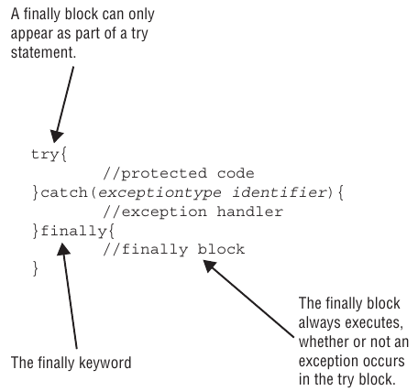
Try catch finally statement
Notes:
Can be used for resources close

Slide 18
Try catch finally statement
Open resource
Try do something with resource and other
Catch any errors
Finally close resource
Notes:
AutoCloseable interface
Try-With-Resources

Slide 19
Try catch finally statement
public void oldSchool(Path path1, Path path2) { BufferedReader in = null; BufferedWriter out = null; try { in = Files.newBufferedReader(path1) out = Files.newBufferedWriter(path2);
out.write(in.readLine()); } catch (IOException e) { log(e); } finally { try { if (in != null) in.close(); } catch (IOException e) { log(e);
} try { if (out != null) out.close(); } catch (IOException e) { log(e);
} } }
Notes:
No boilerplate code anymore!

Slide 20
Try-With-Resources
public void newSchool(Path path1, Path path2) { try (
BufferedReader in = Files.newBufferedReader(path1); BufferedWriter out = Files.newBufferedWriter(path2)
) { out.write(in.readLine()); } catch (IOException e) { log(e); } }
Notes:
Try-With-Resources: resources are closed in reverse order
close() method recommended to be idempotent
close() method should throw most specific exception

Slide 21
Try-With-Resources: Suppressed Exceptions
The idea is that Java treats the first exception as the primary one and tacks on any that come up while automatically closing
Suppressed exceptions apply only to exceptions thrown in the try clause

Slide 22
Try-With-Resources: Suppressed Exceptions
class Bottle implements AutoCloseable { private final int maxVolume; private int currentVolume;
// constructor void addWater(int volumeToAdd) { int probableVolume = currentVolume + volumeToAdd; if (probableVolume > maxVolume) { this.currentVolume = maxVolume; System.out.println("Bottle is full"); throw new IllegalArgumentException("Bottle can not contain more water, it is full!"); } this.currentVolume = probableVolume; System.out.println("Added " + volumeToAdd + ". Current value " + this.currentVolume); } @Override public void close() throws IOException { throw new IOException("Bottle can not be closed, no cap!"); } }

Slide 23
Try-With-Resources: Suppressed Exceptions
try (Bottle bottle = new Bottle()){ bottle.addWater(1); bottle.addWater(1); bottle.addWater(1); bottle.addWater(1); } catch (IOException e) { log("Something happened while adding water: " + e.getMessage()); }
Created bottle with max volume 3
Added 1. Current value 1
Added 1. Current value 2
Added 1. Current value 3
Bottle is full
Exception in thread "main" java.lang.IllegalArgumentException: Bottle can not contain more water, it is full!
at Bottle.addWater(scratch_1.java:17)
at Main.main(scratch_1.java:36)
Suppressed: java.io.IOException: Bottle can not be closed, no cap!
at Bottle.close(scratch_1.java:26)
at Main.main(scratch_1.java:37)

Slide 24
Custom exceptions
class CannotSwimException extends Exception { } class DangerInTheWater extends RuntimeException { public DangerInTheWater() { } public DangerInTheWater(String message) { super(message); } public DangerInTheWater(String message, Throwable cause) { super(message, cause); } }
class SharkInTheWaterException extends DangerInTheWater { }

Slide 25
Stack trace
throw new DangerInTheWater();
Exception in thread "main" DangerInTheWater
at ExceptionExample.main(ExceptionExample.java:3)

Slide 26
Stack trace
throw new DangerInTheWater("broken fin");
Exception in thread "main" DangerInTheWater: broken fin
at ExceptionExample.main(ExceptionExample.java:3)

Slide 27
Stack trace
throw new DangerInTheWater("broken fin“, new RuntimeException(“Can not access water”));
Exception in thread "main" DangerInTheWater: broken fin
at ExceptionExample.main(ExceptionExample.java:3)
Caused by: java.lang.RuntimeException: Can not access water
... 1 more

Slide 28
Assertion
An assertion is a Boolean expression that you place at a point in your code where you expect something to be true
An assertion allows for detecting defects in the code
The syntax for an assert statement has two forms:
assert boolean_expression;
assert boolean_expression: error_message;
Assertions are DISABLED by default.

Slide 29
Assertion
public class AssertionExample { public static void main(String[] args) { int result = calc(0,2,3); assert result > 0 : "Result should be positive"; } private static int calc(int a, int b, int c) { return a * b * c; } }
Exception in thread "main" java.lang.AssertionError: Result should be positive
at AssertionExample.main(AssertionExample.java:4)

Slide 30
Assertions usage:
Validating arguments of a private method (public methods should throw exceptions)
Anywhere in the program to ensure the validity of a fact which is almost certainly true.
Validating post conditions at the end of any method
Validating input parameters of a public method. Since assertions may not always be executed, the regular exception mechanism should be used.
Validating constraints on something that is input by the user. Same as above.
Should not be used for side effects.

Slide 31
Literature
Exceptions

Slide 32
Homework Task 1
Implement the integer parser
int parseInt (String str) throws NumberFormatException
Method takes a string input that should. It should return a parsed number that should be resulting from the conversion of the string. Sting can contain only digits and optionally sign. Not allowed to use methods of Java built-in classes\methods (Integer::parseInt, Integer::valueOf). Program should throw NumberFormatException when parse fails.

Slide 33
Homework Task 2
Implement the user authentication service
User auth(String username, String password) throws AuthException
The User class contains three fields:
int id
String username
String password
The method must search for a user by username in the storage and return found user. If the username or password is empty - WrongCredentialsException. If user is not found, it should throw an exception UserNotFoundException. If the user is found by username, but the password is incorrect - throw WrongPasswrodException.

Slide 34
Homework Task X
Integrate Gradle in Lesson01 and Lesson02 modules
Do commits under lesson 1 and 2 tasks. i.e. commit message:
L01 Integrate gradle framework

Slide 35
Q&A

